Slide 1

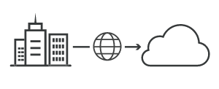

Unit-2: Part B Migrating into cloud
Here starts the lesson!
Abhishek Bhattacherjee

Slide 2
Contents
Broad Approaches to Migrating into the Cloud
The Seven-Step Model of Migration into a Cloud VM Migration
Cloud Middleware and Best Practices
Concept and Need of Cloud Middleware
QoS Issues in Cloud
Data Migration and Streaming in Cloud
Interoperability

Slide 3
Approaches to migrating
It refers to the movement or transfer between different physical machines without any discontinuity.
What challenges and obstacles clients might have to overcome to tap into the cloud?
How their management of IT must change to secure and control their new cloud-driven infrastructure?
When you migrate from a client to the cloud, the issues you will face fall into the following overall categories.

Slide 4
Security
Vendor Management
Issues
Security
Security is an obvious threshold question, if the cloud is not secure, enterprises will not consider migrating to it fearing their sensitive data will be tampered. For eg Users must ensure that they understand the underlying infrastructure of the cloud to which they migrate from their clients and must also advise clients to include security in their cloud SLAs and terms of service.
When the user is going to migrate with the outsource providers, then the service level agreements and its terms are thoroughly checked. While the whole idea behind cloud computing is to
propose a standardized, multi-tenant infrastructure, cloud vendors may not offer the same level
of custom SLAs as IT managers

Slide 5
Technical Integration
The Business View
Most firms that migrate to the cloud environment
in a hybrid model, are keeping certain key elements of their infrastructure in-house and under
their direct control, while outsourcing less susceptible or core components. Integrating internal
and external infrastructures can be a technical concern.
Enterprises around the world have invested trillions of dollars in technology, hoping to improve their execution potential, drive productivity, improve profitability and attain continued competitive advantage. Some have been more successful than others in getting the predictable returns from their technology investments but few, if any, have been able to recognize the full potential of their investments.

Slide 6

The Process: Key Stages in Migrating to the Cloud
While implementing a cloud, migration expected at replacing on a premise major business application may look like, at times, a simple straightforward implementation. It is burdened with pit
falls, which may undermine the true value to the investment, and in fact put enterprises in bad
situation than before.

Slide 7
Understanding and planning for these pitfalls is significant for a successful
deployment of the solution.
IT and business stakeholders must work
together and have to:
● Clearly state business objectives for the cloud migration.
● Define project scope of the cloud migration.
● Provide a set of guiding principles for all to follow.

Slide 8

Seven step migration model
Steps to perform suitable migration

Slide 9
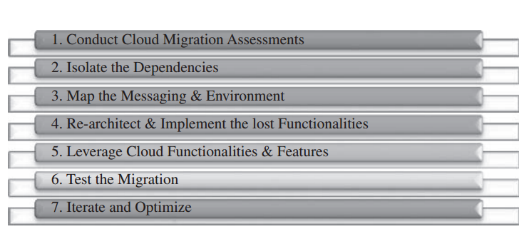

Slide 10
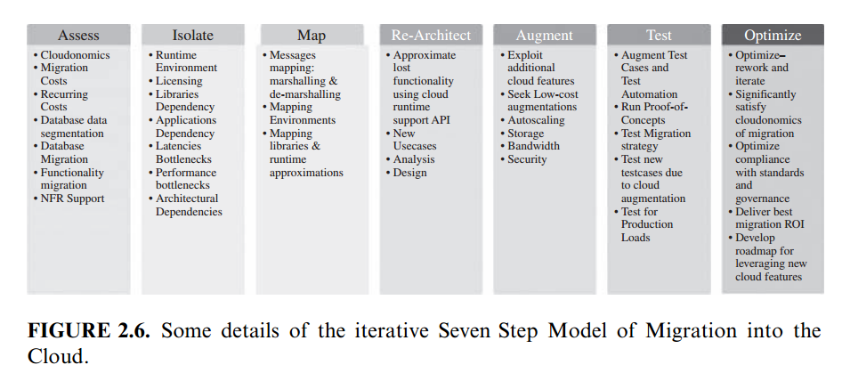
Process

Slide 11

Step 1
These assessments are about the cost of migration as well as about the ROI that can be achieved in the case of production version.
Cloud migration assessments comprise assessments to understand the issues involved in the specific case of migration at the application level or the code, the design, the architecture, or usage levels.

Slide 12
Step 2
Step 3
Isolating all systemic and environmental dependencies of the enterprise application components within the captive data center
Generating the mapping constructs between what shall possibly remain in the local captive data center and what goes onto the cloud.

Slide 13
Step 4
Step 5
substantial part of the enterprise application needs to be rearchitected, redesigned, and reimplemented on the cloud.
We leverage the intrinsic features of the cloud computing service to augment our enterprise application in its own small ways.

Slide 14
Step 6
Step 7
we validate and test the new form of the enterprise application with an extensive test suite that comprises testing the components of the enterprise application on the cloud as well
Test results could be positive or mixed.
In the latter case, we iterate and optimize as appropriate. After several such optimizing iterations, the migration is deemed successful

Slide 15
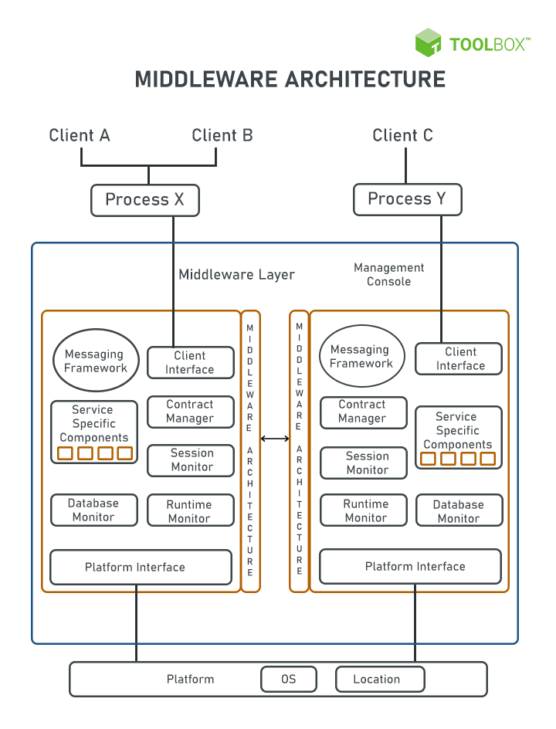

Cloud middleware
Another way to define middleware is to say that it is software that acts as a liaison between applications and networks. The term is often used in the context of cloud computing, such as public or private cloud.

Slide 16
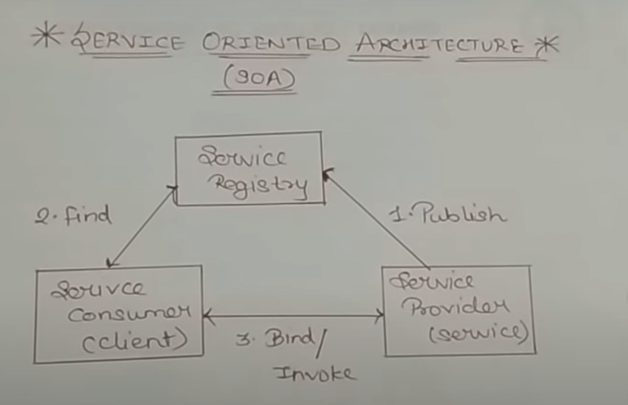
Definition of Concepts
It is adopted by organizations trying to decouple all their business units, depending on integration and reusability for daily operations. SOA allows organizations to use existing application and system investments.
Each of these components must be able to interact with one another and other parts of the system. Apart from some basic components, each type of middleware needs a specific component. For example, a database middleware needs a database manager component.
Most middleware follows the service-oriented architecture (SOA) design or is designed as a platform-as-a-service (PaaS) solution. SOA is an architectural style that tries to achieve loosely coupled software applications that interact among themselves to run as a whole.

Slide 17
What is Loosely Coupled systems??
Example of Middleware
Inside a Single Business Unit
Local Area Network
Geographically decoupled business Units
Cloud Middleware
Local Host
Website
Application Software
Web Server

Slide 18
Components in middleware
Common messaging framework
Middleware requires messaging services to communicate with services, applications, and platforms. Most of these frameworks rely on existing standards such as simple object access protocol (SOAP), representational state transfer (REST), or Javascript object notation (JSON). The communication itself happens through web services or application programming interfaces (APIs).
Middleware management console
This console provides an overview of events and activities, transactions, configuration management, and contract rules.
Platform interface
Middleware needs to work across multiple platforms, irrespective of where it resides. This is the interface that is in direct contact with the backend servers. Ensures compatibility among software.

Slide 19


Need of cloud middleware

Slide 20
Secure connections and data transfer
Configure and control connections and integrations
Middleware typically establishes a secure connection from the front-end application to back-end data sources using Transport Layer Security (TSL) or another network security protocol. And it can provide authentication capabilities, challenging front-end application requests for credentials (username and password) or digital certificates.
Based on information in a client or front-end application request, middleware can customize the response from the back-end application or service. In a retailer's ecommerce application, middleware application logic can sort product search results from a back-end inventory database by nearest store location, based on the IP address or location information in the HTTP request header.

Slide 21
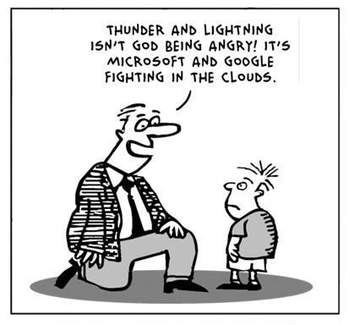
Manage traffic dynamically across distributed systems
When application traffic spikes, enterprise middleware can scale to distribute client requests across multiple servers, on premises or in the cloud. And concurrent processing capabilities can prevent problems when multiple clients try to access the same back-end data source simultaneously.

Slide 22
Quality of service- issues in Cloud
It is a challenge to
implement QoS in cloud computing applications. There are
many techniques to provide quality of service to the cloud
applications. Scheduling, admission control and dynamic
resource provisioning are some techniques used to achieve
that goal.
Quality of Service refers to the ability of networks to attain
maximum bandwidth and handle other network elements
like latency, error rate and uptime. Quality of Service
include the management of other networks resource by
allocating priorities to specific type of data (audio, video
and file).

Slide 23
Challenges
Scheduling:
Cloud service scheduling categorized into two categories:
user level and system level. At user level scheduling deals with problems raised by service providing between both service provider and customer. The system level scheduling handles with resource management in datacenter. Datacenter contain many physical machines, Million request sent from user’s side, scheduling these requests to the physical machines done in datacenter. This scheduling affect the performance of datacenter. Service provisioning in cloud systems based on Service Level Agreement (SLA). SLA is the contract between service provider and customer mentioning the terms of agreement
including the nonfunctional requirement represented as QoS.

Slide 24
Challenges
Admission Control: The main purpose of admission control is to provide strong performance. At admission control time, the Infrastructure Provider (IP) must consider the extra requirement along with the fundamental computational and networking necessities that may be required to be added to runtime so it become flexible.

Slide 25
Challenges
Resource provisioning:
Dynamic resource provisioning is the process of assigning
available resources to the cloud application. Resource
allocation will make services suffer if the allocation not
managed in the right way. Resource provisioning will solve
this problem by allowing the service providers to manage
the resources of modules individually. Resource Allocation
Strategy (RAS) is all about integrating service provider
services activities to allocate insufficient resources within
the limit of cloud environment so that it meets the needs of
the cloud application.

Slide 26
Cloud Interoperability
There is a strong need for the development of integrated interoperability authentication among all provider
Portability implies the ability to move data and applications.
Cloud interoperability. This term refers to the ability of two or more systems or applications to exchange information and to use the information that has been exchanged together.

Slide 27
Categories while migration
Platform Portability: It means application development environment or IDE should be capable enough to run over any type of cloud infrastructure.
Infrastructure Portability: It means virtual server or machine images should have the freedom of portability. They should be able to migrate from one cloud provider to another.
When consumer wishes to migrate from one cloud Provider to another, interoperability falls into these categories:
Data and Application Portability: It means by running applications and data, consumers should be able to migrate easily from one cloud provider to another without any lock-in issue.

Slide 28
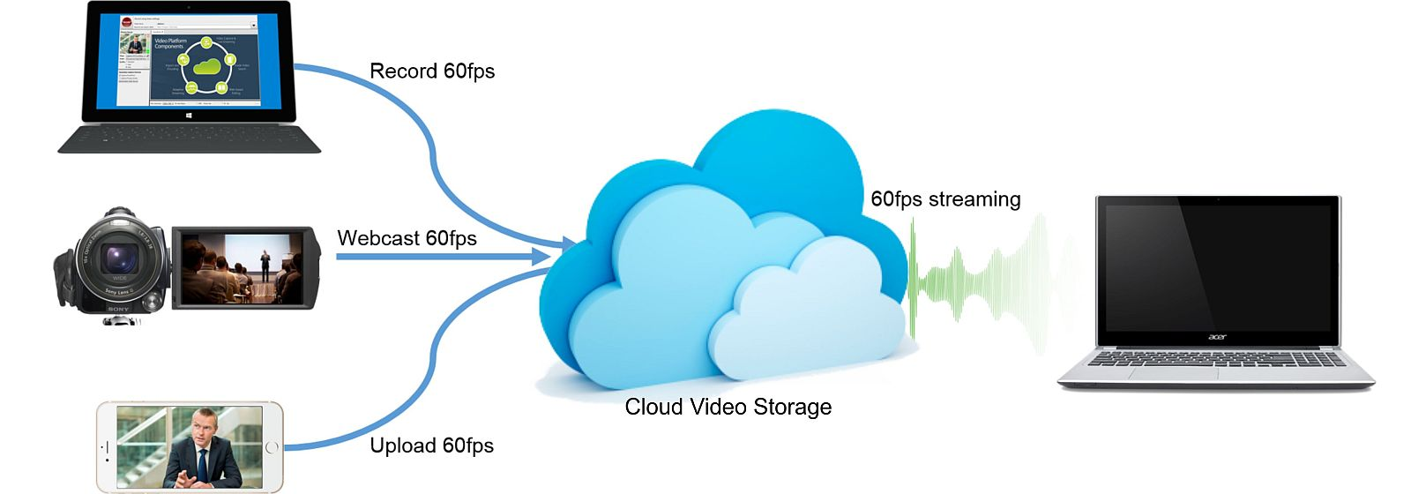
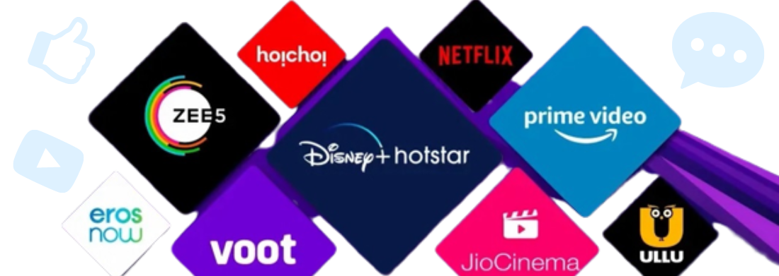
Streaming
The technology of transmitting audio and video files continuously over a wired or wireless internet connection.
How does streaming work?
Music, video, and other types of media files are prearranged and transmitted in sequential packets of data so they can be streamed instantaneously. And unlike traditional downloads that are stored on your device, media files are automatically deleted once you play them. All you need to stream is a reliable and fast high-speed internet connection, access or subscription to a streaming service or app, and a compatible device.
cloud-based video streaming or cloud video streaming is a technology that allows users to consume digital video content over the internet without downloading it first.

Slide 29
What Are The Advantages Of Cloud Video Streaming?
1. Cost-Friendly
2. More Accessibility
3. Zero Purpose For Individual Infrastructure
4. Handling To Scale At Max Level
5. Boundless Storage Capacities
6. Top-level Security
7. Everlasting Continuity
8. Focused CDN Solution
9. Cloud Transcoding
10. Video Content Management System
11. Live Recording
12. Cloud Storage
13. Video Analytics
14. Video Player
15. Video Monetization

